Slide 1


Data Science
(24AD3107)
Project title :
E-Commerce Customer & Sales Analytics
Team members :
B Nageshwari – 2420030426
R Ananya – 2420030086
Harini - 2420030629
Notes:
Course: Data Science (24AD3107), A.Y. 2026-2027. Team: Bingi Nageshwari (2420030426), Remani Sri Ananya (2420030086), Ch. Harini (2420030629). Guide: Dr. N. Sunanda. Department of CSE, KLEF.

Slide 2

Introduction
Converts customer histories into behavioral indicators instead of treating transactions independently
Describes customer value using Annual Spending, Purchase Frequency, and Average Order Value
Applies K-Means clustering to discover behavioral segments
Communicates results through an RFM-based interactive dashboard
Notes:
Motivation: transaction tables are too large for manual review; a multidimensional behavioral view is needed.

Slide 3
Project Objectives
Analyze customer behavior and sales performance from historical order data
Engineer customer-level features that capture spending, frequency, and order value
Segment customers into behavioral groups using unsupervised learning
Build visual reports and dashboards to make large datasets easy to interpret
Support data-driven decisions to increase sales and improve customer satisfaction
Notes:
Primary goal: from raw data to interpretable customer segments and visual reporting.

Slide 4
K-Means Customer Segmentation
K-Means assigns customers to groups by minimizing within-cluster variation around centroids
The implemented analysis produces six clusters (K = 6)
Each cluster is summarized using its size and mean behavioral measurements
Cluster statistics allow groups to be compared without relying on individual observations
Segments reveal differences in customer value that revenue alone cannot show
Notes:
K-Means: partitions data into K clusters where each observation belongs to the cluster with the nearest mean.

Slide 5
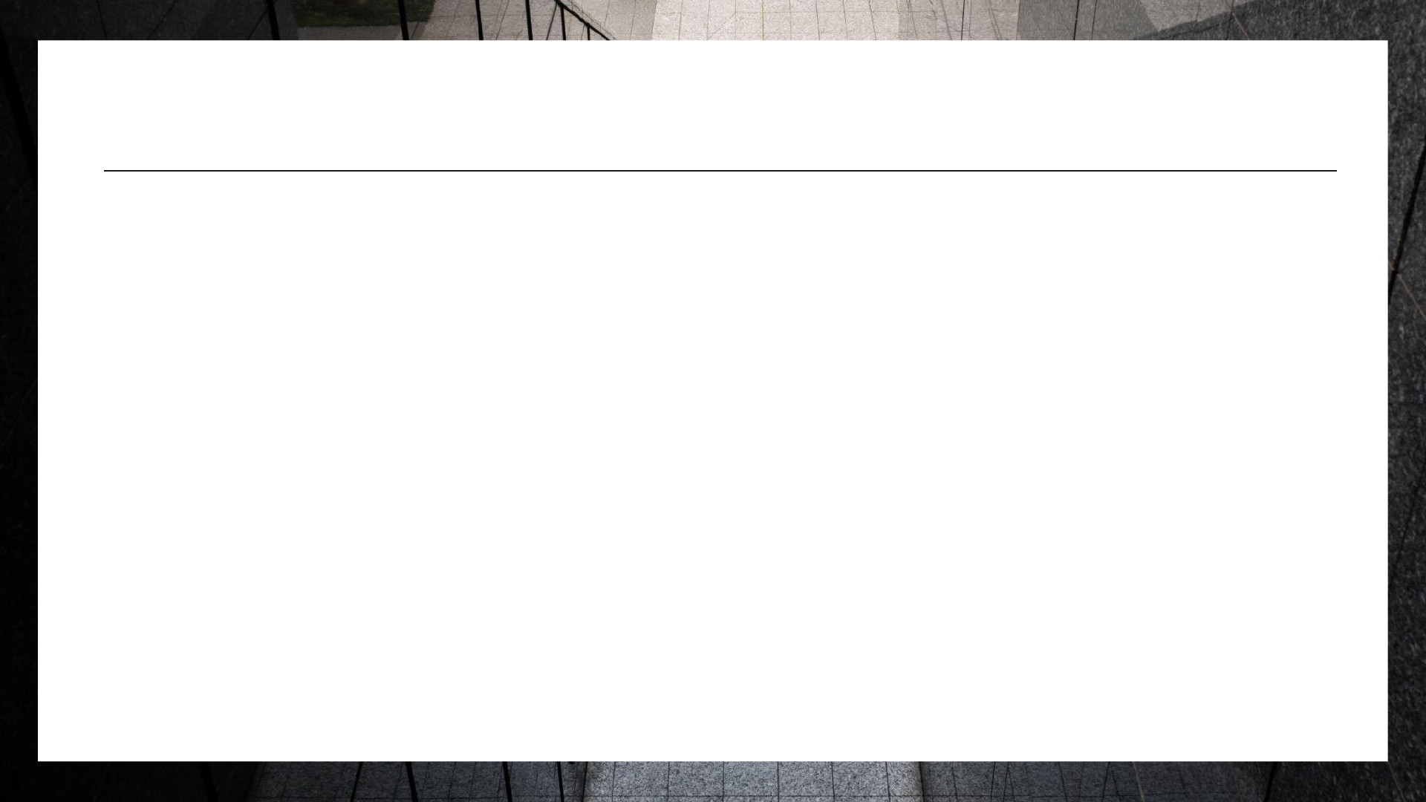
Cluster Results — K = ​6
Cluster | Size | Avg Spending | Avg Frequency | Avg Order Value
Cluster 0 | 119 | 44,154.64 | 27.12 | 122.57
Cluster 1 | 178 | 33,587.68 | — | 203.45
Cluster 2 | — | 45,121.93 | 34.40 | —
Cluster 3 | — | 56,361.96 | — | 266.78
Cluster 4 | — | 65,693.59 | — | —
Cluster 5 | — | 58,854.61 | 13.75 | —
Notes:
Data from the research paper: six clusters differ substantially in spending, frequency, and order value. Cluster 1 is the largest (178 customers); Cluster 4 has the highest mean spending; Cluster 2 the highest frequency; Cluster 3 the highest order value.

Slide 6

Cluster Visualization
Spending vs Purchase Frequency — how purchasing intensity varies with customer spending
Spending vs Average Order Value — where financial contribution comes from larger orders
Frequency vs Average Order Value — another perspective on purchasing style
Partial overlap between clusters is expected when behavior varies continuously
Notes:
Fig. 2: K-Means customer segmentation output for K=6 with cluster statistics and pairwise behavioral plots.

Slide 7
Customer Segmentation Dashboard
Summarizes Recency, Frequency, and Monetary (RFM) indicators
Displays customer segments using a distribution chart
Includes an RFM score heatmap for quick pattern recognition
Insights panel highlights selected segment-level observations
Notes:
Fig.. 1: Customer segmentation dashboard containing RFM indicators, segment distribution, heatmap, and analytical insights.

Slide 8
Dataset Overview
Contains orders, customers, products, sales, profit, quantity, discounts, and regions
Provides the transaction history needed to compute customer-level indicators
Suitable for demonstrating real-world data analysis techniques in the retail industry
Source: Kaggle — Superstore Dataset (Final)
Notes:
Download: https://www.kaggle.com/datasets/vivek468/superstore-dataset-final

Slide 9
Proposed Methodology
Data Collection — e-commerce customer and purchase information
Data Preprocessing — cleaning incomplete, repeated, inconsistent, and extreme records
Exploratory Data Analysis — inspect spending and purchasing distributions
Customer-Level Feature Engineering — Annual Spending, Purchase Frequency, Average Order Value
K-Means Segmentation — group customers into six behavioral clusters
Cluster Evaluation & Interpretation — summary statistics and pairwise scatter plots
Interactive Dashboard — RFM indicators, segment counts, heatmap, insights panel
Notes:
Pipeline: Customer Transaction Data → Cleaning → Feature Construction → EDA → K-Means → Cluster Profiling → Visual Analytics Dashboard.

Slide 10
Conclusion
Combines customer-level feature engineering with K-Means clustering to reveal six behavioral groups
Demonstrates that customer value is multidimensional — spending, frequency, and order value tell different stories
Dashboard provides a separate communication layer where RFM indicators and segment views are examined together
Forms a practical framework for exploring customer behavior in e-commerce datasets
Notes:
Statistical summaries + clustering + visualization = a complete, interpretable analytics framework.

Slide 11
Future Scope
Incorporate additional variables: product-category diversity, discount usage, return activity, customer lifetime value
Compare different cluster counts and alternative clustering algorithms
Add demand forecasting, churn-risk analysis, and personalized product recommendation
Build customer-level drill-down pages and automated reporting
Notes:
These extensions connect descriptive customer analytics with predictive and prescriptive applications.

Slide 12
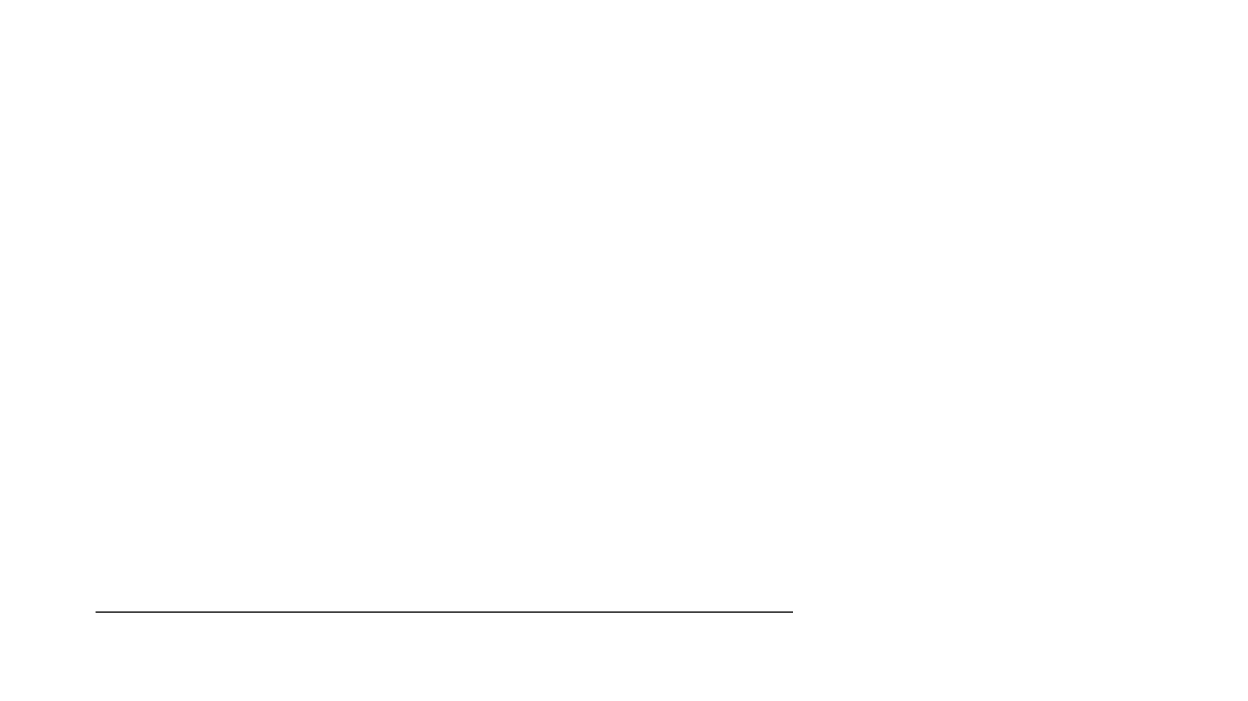
Thank You
Bingi Nageshwari (2420030426)
Remani Sri Ananya (2420030086)
Ch. Harini (2420030629)
Guide: Dr. N. Sunanda
Notes:
References: Wu et al. (2021); Li et al. ((2022); Wu et al.((2022); Gomes & Meisen ((2023); Mehta & Sehgal ((2024).

